Slide 1

INTERNET
What is it !

Slide 2
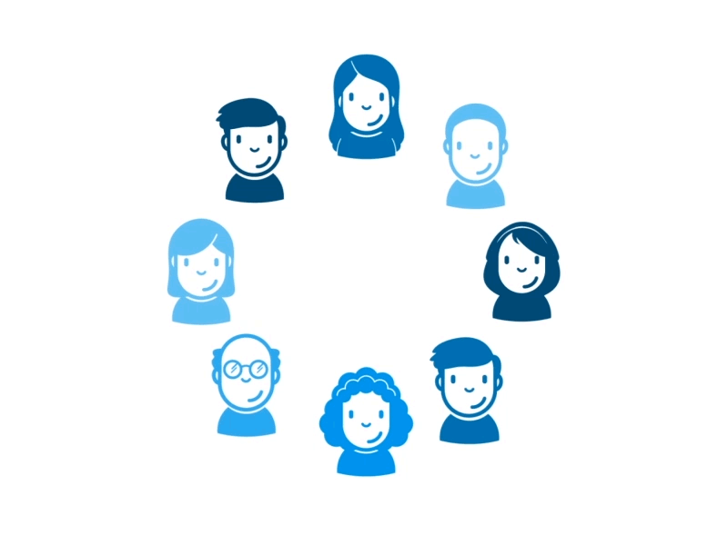
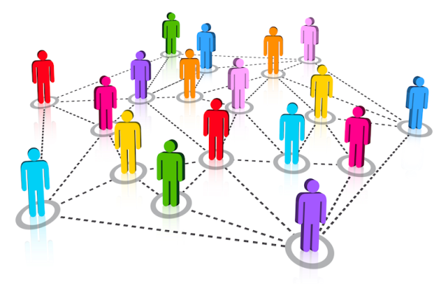
Let us first understand what is networking .
1. Network of friends.
2. Network of railways .
3. Network of phones.

Slide 3
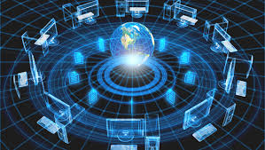
Where did it all start ?

Slide 4
Advanced Research Projects Agency Network, ARPANET was developed by United States.
ARPANET was created to make it easier for a more effective communication method for the military.
It was the beginning of Internet today.

Slide 5
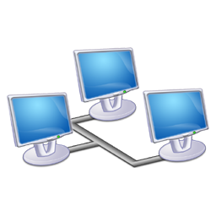
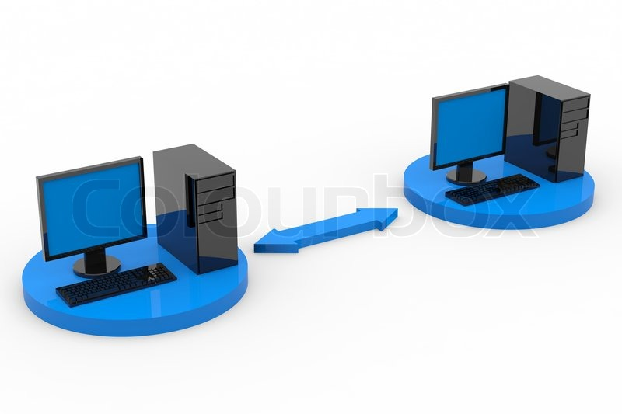
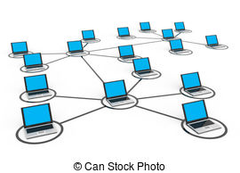
Computer network is an inter connection of a number of computers to share data and resources and for faster communication.

Slide 6
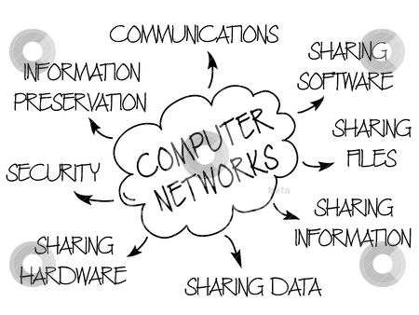

Slide 7
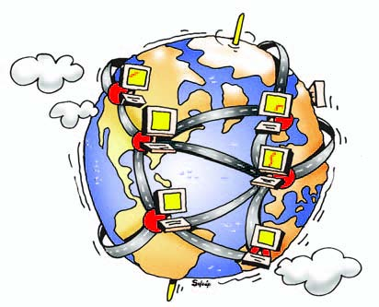
The Internet
Many people use the net,
And most haven't had trouble yet.
They will never get the flu
But they will get a virus or two.
Internet can be really great.
But make sure you're safe before it's too late.
Be sure that your real name isn't known
And that your face isn't shown.
By Emma

Slide 8
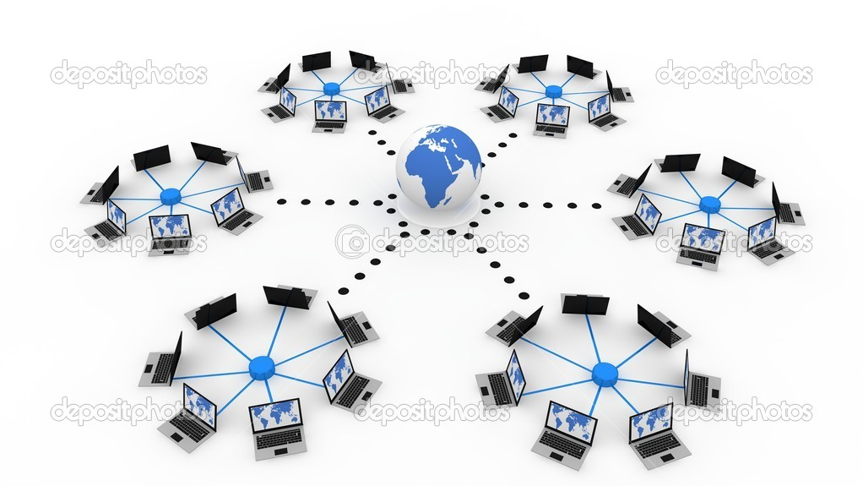

Slide 9
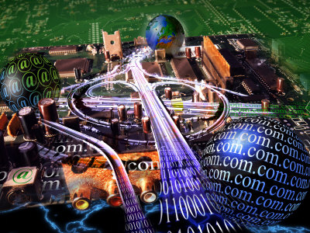
Internet is a connection of millions and millions of computers all over the world. Also called Information Super Highway , a network of networks.
These computers can ‘talk’ to each , even though they are of different configuration and have different Operating Systems.

Slide 10
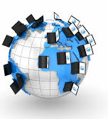
How ?
Because these computers follow the same set of rules or PROTOCOLS.

Slide 11
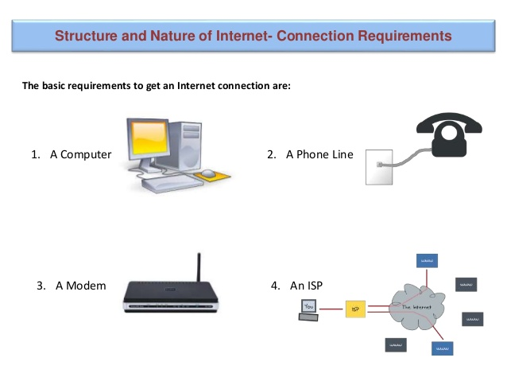
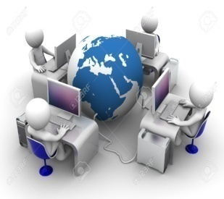

Slide 12
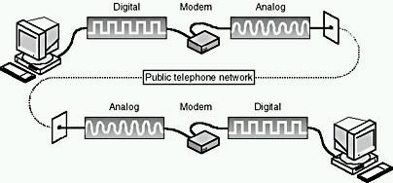
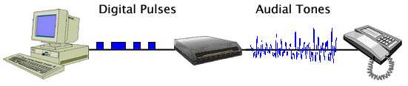
MODEM
( Modulator or Demodulator)
Modem converts the digital signals which the computer given out into analog signals and converts the analog signal back to digital at the receiving computer.

Slide 13
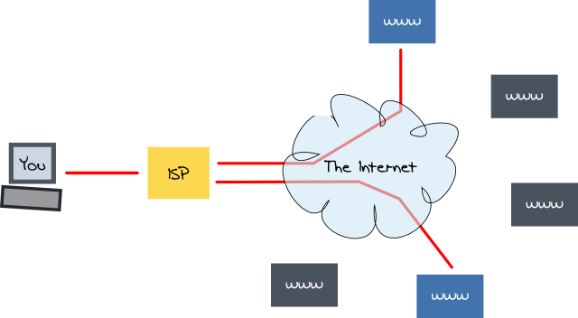
The ISP - is a company that provides us internet access using their own high speed computer.
For example : Airtel, Reliance etc.
An ISP is your gateway to the Internet and everything else you can do online.
As soon as your connection is setup with an ISP you are ready to go.

Slide 14
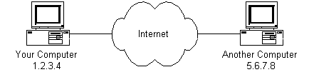
Each computer on the internet has a unique address called the IP Address.

Slide 15
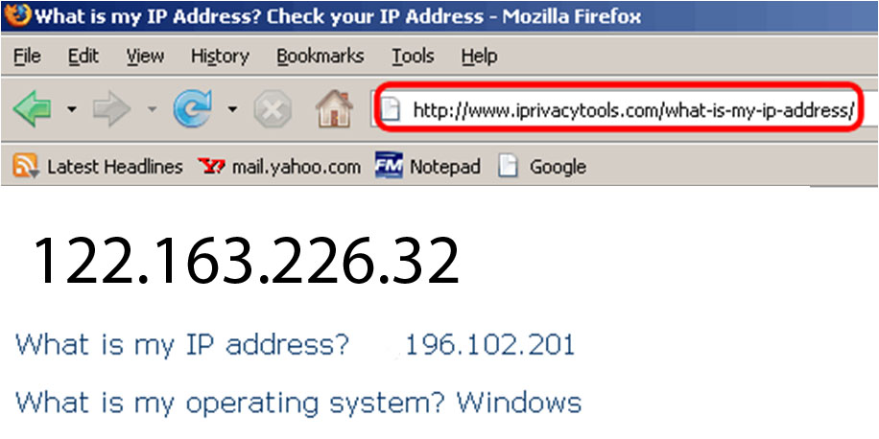
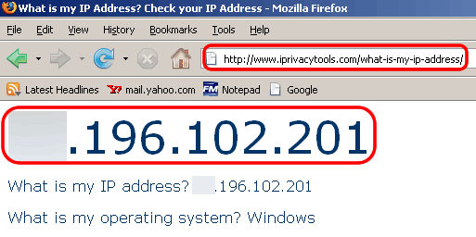

Slide 16
Protocol means rules.
It is method of exchanging data over a computer network.
Each protocol has its own method of how data is formatted when sent and what to do with it once received, how that data is compressed or how to check for errors in data.
Some the most common and known are protocols are:
HTTP(for web pages)
TCP/IP (how data is sent)
back

Slide 17
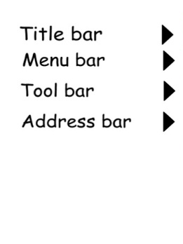
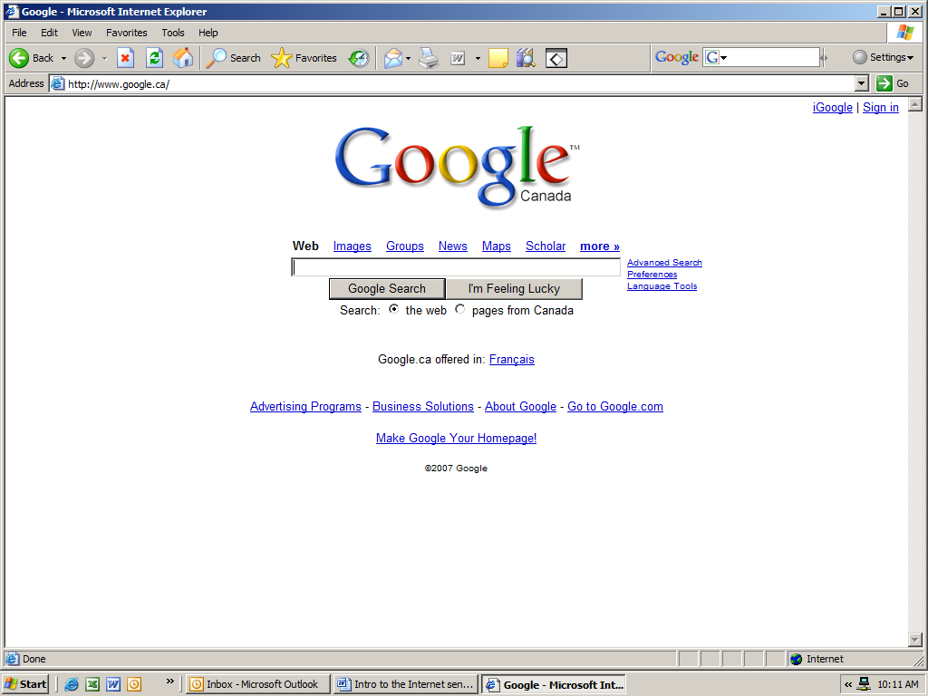
Layout of a Web Page
Title bar – tells you the name of the web page
Menu bar – has commands for moving around the webpage, printing, etc
Tool bar – short cuts to commands. Each picture represents a command
Address bar – webpage address. If you want to go directly to a web page, you will need to know the address.

Slide 18


Some Common Terms
The Internet is a network of computers spanning the globe. It is also called the World Wide Web.
An Internet Browser is a software program that enables you to view Web pages on your computer. Browsers connect computers to the Internet, and allow people to “surf the Web.”
Internet Explorer is one of the browsers most commonly used. There are other browsers available as well, including Netscape.

Slide 19
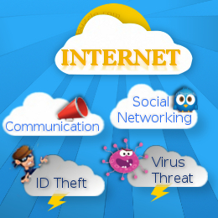

Slide 20
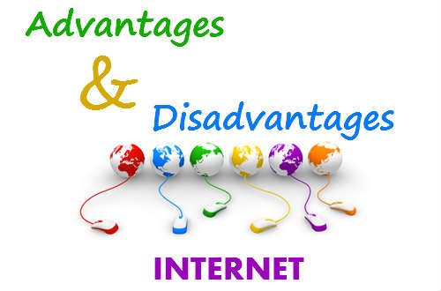

Slide 21
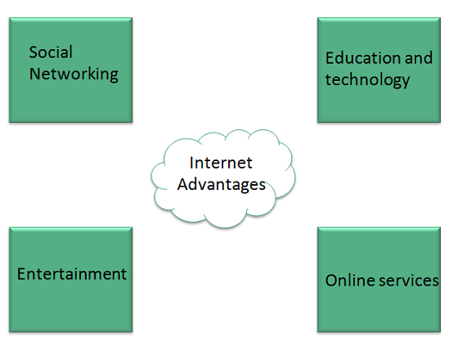

Slide 22
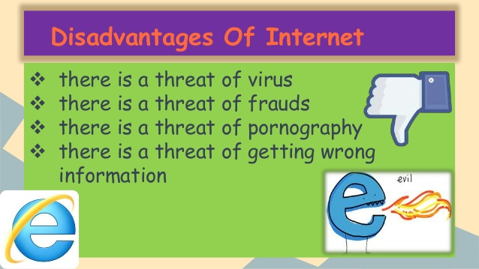

Slide 23
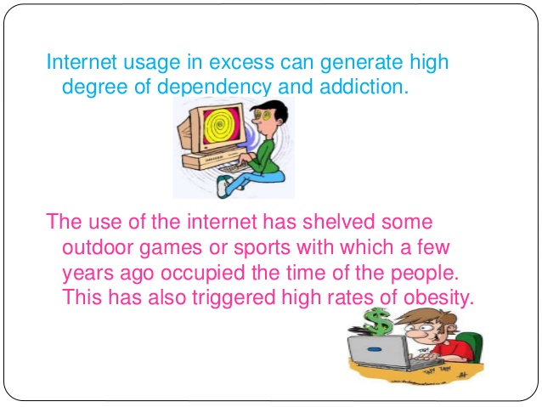

Slide 24
FEW TERMS

Slide 25
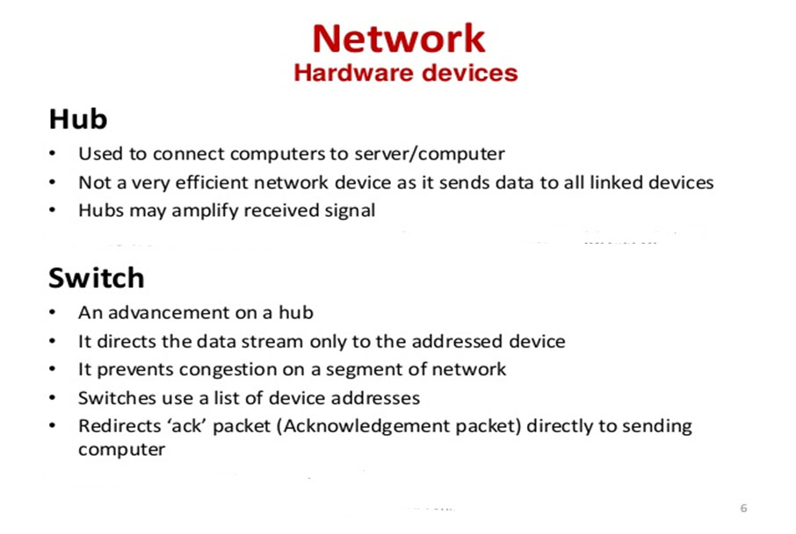

Slide 26
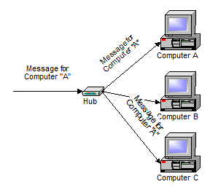
A HUB

Slide 27
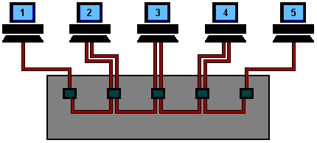
A HUB

Slide 28
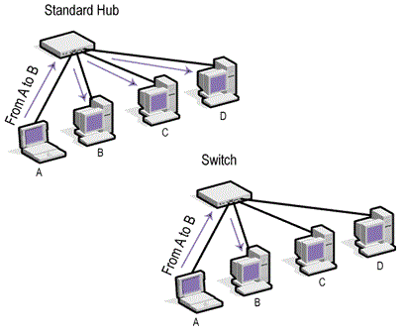

Slide 29
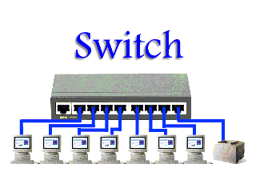

Slide 30
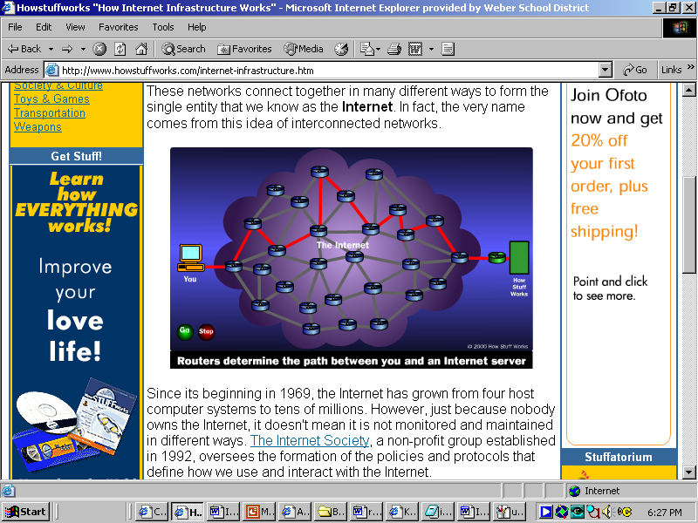

Slide 31
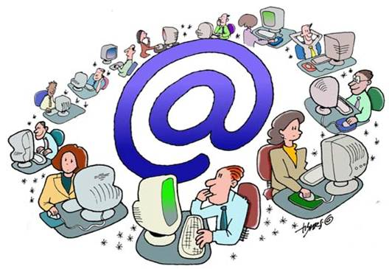
Made with inputs and images from the internet

